Slide 1
Need CE credit for this
session?
Please don’t forget to
scan in to have your
attendance tracked.

Slide 2
Prompting “away-towards” distinction in health behavior change.
Ben Pierce, M.S., Michael E. Levin, Ph. D., & Benjamin Schoendorff, M.A., M.Sc.
Notes:
Health behavior = Diet, exercise, or any other behavior linked directly to physical health

Slide 3
Overview
The Matrix and Health Behavior
Study Design
Findings
Recommendations

Slide 4
Current Health Behavior Change Interventions
RCTs of individual, school-based, and community interventions show moderate effects(Heath et al., 2012)
However…
Small effect sizes for self-help and web-based interventions (Webb et al., 2010)
Sustained intervention effects unclear (Butryn et al., 2011)
Need for simple, widely accessible approaches (Klesges et al., 2004).
Many interventions entail extensive self-monitoring.
Difficult to implement with fidelity.
…Maybe the Matrix can help with this.
Notes:
Sustained – Often, target weights, exercise levels, eating habits, etc. are not maintained at follow-up.
Meta analysis : 0.16-0.36

Slide 5
Primary Research Question
Is it possible to change health behavior by simply prompting the “away-towards” distinction?

Slide 6
Trends in Effective Interventions (Michie et al., 2009)
Intention setting and goal clarification.
Self-Monitoring.
Continuous feedback.
Specific/behavioral feedback.

Slide 7
Trends…
ACT (Lillis & Kendra, 2014)
Acceptance of internal barriers.
Behavior as outcome.
Encourages goal setting, but does not supply goals (e.g. weight loss)
Focus on internal motivation
Commitment.

Slide 8
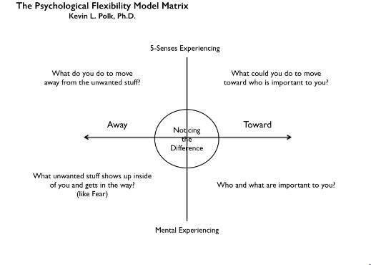
The Matrix
Contextual “sorting” exercise.
Behavioral Focus
Self-monitoring
Away/Towards
Internal barriers
Values
Feedback
Notes:
Components of the Matrix are consistent with what is known to be effective.

Slide 9
The Matrix App
Provide in-the-moment feedback on away-towards.
Practice “sorting” in real-time.
EMI
2 questions:
Are you moving away or towards?
If moving towards, how difficult was it to get started?

Slide 10
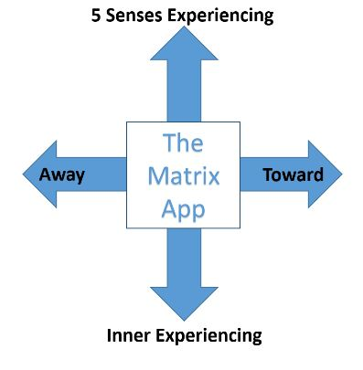
Pilot Study
Procedures
Pretest and Random Assignment
Orientation to the Matrix:
Define goals
Walk-through
Download & Use app for 2 weeks
EMI plus self-checkin
Coaching call @ week 1
Follow-up @ week 2
Notes:
PPL created personal matrix during walk-through.

Slide 11
Pilot Study
24 participants [13 Matrix, 11 Control]
14 Women, 10 Men
Mean Age 26.41
16 from community, 8 from undergraduate courses
21 identified White race, 3 did not respond
4 identified Latino/a ethnicity
Median income bracket was $20,000 – $40,000
Health Related Questions
6 Matrix and 8 control participants at least slightly dissatisfied with eating habits
6 Matrix and 7 control participants at least slightly dissatisfied with exercise
Notes:
White sample consistent with college town where study was run.

Slide 12
Pilot Study
Measures:
Weight Control Strategies Scale (WCSS; Pinto et al., 2013)
Dietary Choices, Self-Monitoring, Physical Activity, Psychological Coping
Emotional Eating (DEBQ-EE; Van Strein et al., 1986)
Weight Self-Stigma (WSSQ; Lillis et al., 2010)
Self-Stigma, Fear of Enacted Stigma
Psychological Inflexibility
Food (FAAQ; Juarascio et al., 2011)
Body Image (BIAAQ; Sandoz et al., 2013)
Valuing Questionnaire (VQ; Smout et al., 2014)
Global Health (GHS; Hays et al., 2009)
Physical Heath, Mental Health

Slide 13
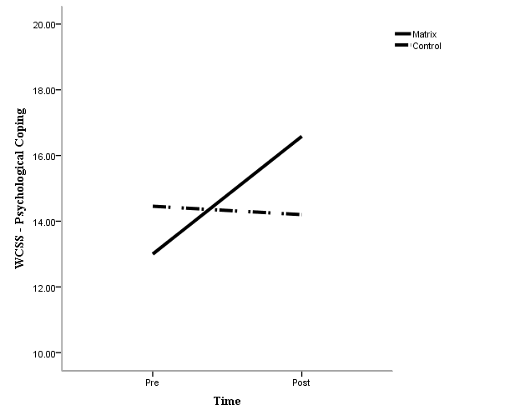
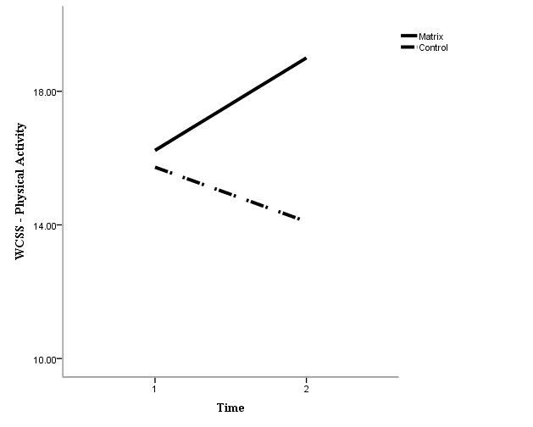
Findings – Pre-Post
Mixed ANOVA Results (Type 3 SS)
WCSS – Physical activity F(1, 20.9) = 2.949, p = .10
WCSS – Psychological coping F(1, 19.1) = 5.646, p = .03
All other measures, n.s

Slide 14
Findings – EMI
Model 1: DV = Towards (0 = Away, 1 = Towards)
Level 1
Bprompt = -0.004, n.s.
Level 2
Bday = 0.042, p = .048
exp(Bday) = 1.043
Level 3
Mean Threshold = -0.576, p < .001
exp(threshold) = 56.3% baseline probability
Notes:
This means…

Slide 15
Findings – EMI
Model 2: DV = Difficulty (0 = easy, 1 = fairly hard, 2 = very difficult)
Level 1
Bprompt = 0.012, p = .004
Level 2
Bday = -0.030, p = .029
Level 3
Mean = 0.555, p < .001
Notes:
This means…

Slide 16
Findings
What did you like?
Simplicity
Ease of use
Ongoing feedback
What did you learn?
“That I always have a choice in my life. I can decide exactly who and what I want to be and how and why I do that at any time.”
“I was able to consider a lot of actions that are influencing my goals that I didn't think about before.”

Slide 17
Findings
What did you dislike?
Simplicity
Repetitiveness
Lack of motivational content
Notes:
Motivation: PPL didn’t have their personal matrices with them at all times, a lot mentioned the need to revisit values in prompts.

Slide 18
Summary
Using the matrix app…
Increased the probability of a “towards” move over time
Reduced difficulty of making “towards” moves
May have increased physical activity and psychological coping
Did not affect other flexibility processes, weight self-stigma, self-rated global health.
According to participants…
Simplicity and ongoing feedback were helpful
Too much simplicity = repetitive
Lacked motivational content

Slide 19
Implications
Sorting on the “away-towards” dimension alone can increase “towards moves.”
Committed action?
More comprehensive / tailored approaches -> other flexibility processes
Ability to add values, inner barriers, and away/towards moves to the Matrix.
Other motivational content?

Slide 20
Next Steps
A customizable Matrix app.
With tailored interventions for “away moves”
Adjunctive Matrix app.
Can we support progress in therapy?

Slide 21
References
Ciarrochi, J., Fisher, D., & Lane, L. (2011). The link between value motives, value success, and well‐being among people diagnosed with cancer. Psycho‐Oncology, 20, 1184-1192.
Fairburn, C. G., & Beglin, S.J. (1994). Assessment of eating disorder psychopathology: Interview or self-report questionnaire? International Journal of Eating Disorders, 16, 363-370
Ferssizidis, P., Adams, L. M., Kashdan, T. B., Plummer, C., Mishra, A., & Ciarrochi, J. (2010). Motivation for and commitment to social values: The roles of age and gender. Motivation and Emotion, 34, 354-362.
Gregg, J. A., Callaghan, G. M., Hayes, S. C., & Glenn-Lawson, J. L. (2007). Improving diabetes self-management through acceptance, mindfulness, and values: A randomized controlled trial. Journal of Consulting and Clinical Psychology, 75, 336-343.
Godin, G., & Shephard, R. J. (1985). A simple method to assess exercise behavior in the community. Canadian Journal of Applied Sport Sciences, 10, 141-146.
Godin, G., & Shephard, R. J. (1997). Godin leisure-time exercise questionnaire. Medicine and Science in Sports and Exercise, 29, S36-S38.
Hays, R. D., Bjorner, J. B., Revicki, D. A., Spritzer, K. L., & Cella, D. (2009). Development of physical and mental health summary scores from the patient-reported outcomes measurement information system (PROMIS) global items. Quality of Life Research, 18, 873–880
Hayes, S. C., Strosahl, K. D., & Wilson, K. G. (2011). Acceptance and Commitment Therapy: The process and practice of mindful change. New York: The Guilford Press.
Heron, K. E., & Smyth, J. M. (2010). Ecological momentary interventions: Incorporating mobile technology into psychosocial and health behavior treatments. British Journal of Health Psychology, 15, 1-39.
Jacobs Jr, D. R., Ainsworth, B. E., Hartman, T. J., & Leon, A. S. (1993). A simultaneous evaluation of 10 commonly used physical activity questionnaires. Medicine and Science in Sports and Exercise, 25, 81-91.
Juarascio, A., Forman, E., Timko, C. A., Butryn, M., & Goodwin, C. (2011). The development and validation of the food craving acceptance and action questionnaire (FAAQ). Eating behaviors, 12, 182-187.
Lillis, J., Hayes, S. C., Bunting, K., & Masuda, A. (2009). Teaching acceptance and mindfulness to improve the lives of the obese: A preliminary test of a theoretical model. Annals of Behavioral Medicine, 37, 58-69.
Lillis, J. & Kendra, D.E. (2014). Acceptance and commitment therapy for weight control: Model, evidence and future directions. Journal of Contextual Behavioral Science, 3, 1-7.
Lillis, J., Luoma, J., Levin, M.E. & Hayes, S.C. (2010). Measuring Weight Self Stigma: The Weight Self Stigma Questionnaire. Obesity, 18, 971-976.
Lugt, A. A. V. (2014) The pain matrix. In K. L. Polk & B. Schoendorff (Eds.), The ACT Matrix:
A new approach to building psychological flexibility across settings and populations, (pp.
93-108). Oakland, CA: New Harbinger Publications.
Newman, D. A. (2003). Longitudinal modeling with randomly and systematically missing data:
A simulation of ad hoc, maximum likelihood, and multiple imputation techniques.
Organizational Research Methods, 6, 328-362.
Niemeier, H. M., Leahey, T., Reed, K. P., Brown, R. A., & Wing, R. R. (2012). An acceptance-based behavioral intervention for weight loss: A pilot study. Behavior Therapy, 43, 427-435.
Pinto, A.M., Fava, J.L., Raynor, H.A., LaRose, J.G. & Wing, R.R. (2013). Development and validation of the weight control strategies scale. Obesity, 21, 2429-2436
Polk, K. L., & Schoendorff, B. (Eds.). (2014). The ACT Matrix: A new approach to building
psychological flexibility across settings and populations. Oakland, CA: New Harbinger
Publications.
Sandoz, E. K., Wilson, K. G., Merwin, R. M., & Kellum, K. K. (2013). Assessment of body
image flexibility: The body image-acceptance and action questionnaire. Journal of
Contextual Behavioral Science, 2, 39-48.
Schoendorff, B., & Bolduc, M. F. (2014). You, me, and the matrix: A guide to relationship-
oriented ACT. In K. L. Polk & B. Schoendorff (Eds.), The ACT Matrix: A new approach
to building psychological flexibility across settings and populations, (pp. 57-76). Oakland, CA: New Harbinger Publications.
Shiffman, S., Stone, A. A., & Hufford, M. R. (2008). Ecological momentary assessment. Annual
Reviews of Clinical Psychology, 4, 1-32.
Tabachnick, B. G. & Fidell, L. S. (2013). Using multivariate statistics (6th ed.). Upper Saddle
River, NJ: Pearson.
Van Strien, T., Fritjers, J.E.R., Bergers, G.P.A. & Defares, P.B. (1986). The Dutch eating
behavior questionnaire (DEBQ) for assessment of restrained, emotional, and external
eating behavior. International Journal of Eating Disorders, 5, 295-315.
Webster, M. (2014). Rolling out the matrix, rolling back addiction. In K. L. Polk & B.
Schoendorff (Eds.), The ACT Matrix: A new approach to building psychological
flexibility across settings and populations, (pp. 77-92). Oakland, CA: New Harbinger Publications.
Weineland, S., Arvidsson, D., Kakoulidis, T. P., & Dahl, J. (2012). Acceptance and commitment therapy for bariatric surgery patients, a pilot RCT. Obesity Research & Clinical Practice, 6, 21-30.

Slide 22
Need credit for this session?
Please don’t forget to
scan out.
What did you think?....
complete the 3 question quickeval
for this session at
https://contextualscience.org/quickeval
This was presentation was session #97

